Slide 1


DATA WRANGLING/CLEANING USING EXCEL

Slide 2


Primitive data types:
There are five main types of data types in Excel:
Booleans: (True/False, Male/Female, Default/Not Default,....)
Characters: (‘A’, ’c’, ‘D’,...)
Strings: (sets of characters: “Home”, “I like my dog”,...)
Integers: (-1, 2, 5, 400,...)
Floating point: (-13.5, 26.8, 13E6,...)

Slide 3
Data cleaning process
Data cleaning is mandatory as in data analytics the main rule is:
“Garbage in/ Garbage out”
We need to clean our data, but this is a needed condition but not sufficient to guarantee a good model.
Every model may need a different preprocessing.

Slide 4
Excel formulas
Excel cells can return values from any other cell in the workbook
Those values can be transformed using formulas
In order to add a formula to an Excel cell, you need to add the “=” sign and then the name of the formula alongside it’s arguments
Excel comes with many built-in formulas

Slide 5
Excel formulas to import data
Data contained in another cell can be obtained using the syntax:
Range_fo_cells
Data from other worksheets of the same workbook can be included in an Excel formula using the syntax:
‘Sheet_name’!Range_of_cells
In a similar way, if the data that we want to import is stored in a different workbook, we can use the syntax:
‘[Another_file.xlsx]Worksheet_name’!Range_of_cells
‘[full_path_to_excel_file]Worksheet_name’!Range of_cells (if the file is closed)

Slide 6
String functions in Excel
LEN( cell_name ): provides the length of the characters found in “cell_name”
LEFT( cell_name, number_of_characters ): returns “number_of_characters” of “cell_name starting from the left
RIGHT( cell_name, number_of_characters ): returns “number_of_characters” of “cell_name starting from the right
MID( cell_name, start, number_of_characters): returns “number_of_characters” from “cell_name” starting from “start” position
FIND( cell_name, “string”): if “string” exists in “cell_name”, returns the starting position
IF ( condition, value_if_true, value_if_false ). It can be nested with another “IF” inside the function.
https://www.edupristine.com/blog/text-functions-excel

Slide 7
Data standarization
What is it?
All the values need to follow the same format, units, code...
Why is needed?
To allow any model to extract meaningful patterns.
Different ranges of values in each column favor the column with the biggest range in predicting the dependent variable. (the remaining columns are barely used in the prediction)

Slide 8
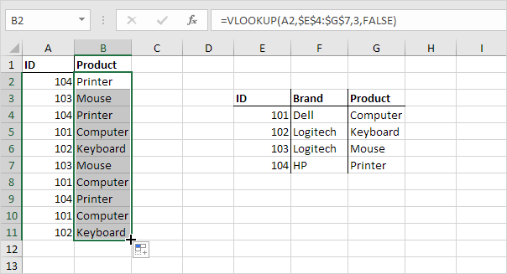
Function Vlookup
The VLOOKUP (Vertical lookup) is a function which given a value in one table, finds the corresponding value in another table with a common column
VLOOKUP(value_to_search , range_for search, column_to_import, na_values )
https://www.excel-easy.com/functions/lookup-reference-functions.html
In the example on the right image we would like fill out the “Product” column “G” according to the product “ID” with the values on column “B”
VLOOKUP(E4,$A$1:$B$11,2,0)
In case of duplicates, vlookup returns the first match.

Slide 9
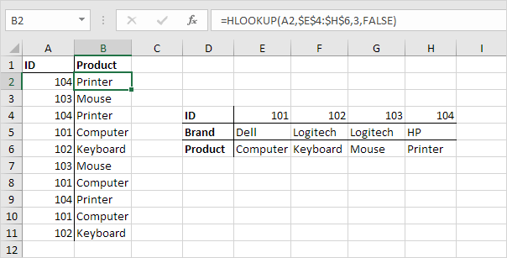
Function Hlookup
The HLOOKUP (Horizontal lookup) is a function which given a value in one table, finds the corresponding value in another table horizontally.
HLOOKUP(value_to_search , range_to_search, column_to_import, na_values)
https://www.excel-easy.com/functions/lookup-reference-functions.html
In the example on the right, we want to fill the second table with the product name.
HLOOKUP(E4;$A1:$B11;2;0)

Slide 10
Excel limitations
Small files
Total number of rows and columns on a worksheet
1,048,576 rows by 16,384 columns
Bigger files can’t be read from Excel and they are quite common nowadays
00

